Slide 1
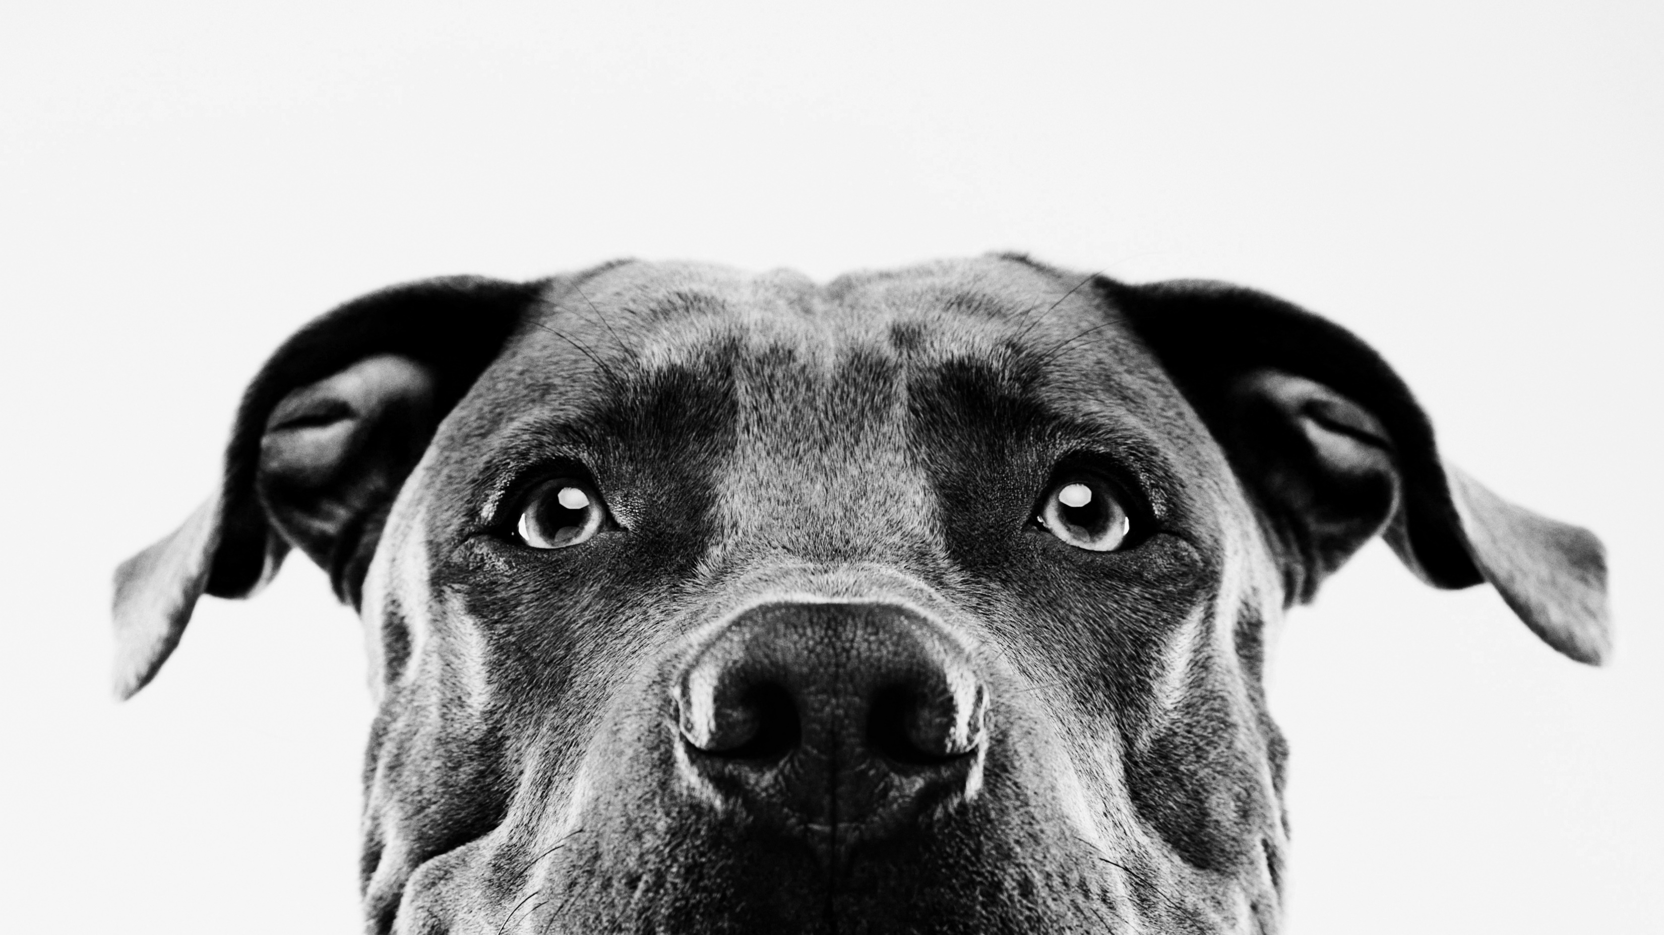
LET’S HAVE SOME FUN PLAYING SYMBOLIC PICTIONARY!

Slide 2
HOPE

Slide 3
LOVE

Slide 4
PEACE

Slide 5
WISDOM

Slide 6
HARD-WORK

