Slide 1


New K-12 Student Reporting Policy Draft
By: Carly Lorntsen & Amanda Sumption
UNBC School of Education, EDUC 421 – Assessment and Motivation

Slide 2


Land Acknowledgement
With gratitude and respect, we would like to acknowledge that we work, learn, and study in the Quesnel region, on the traditional, ancestral, and unceded territory of the Dakehl people (Lhatko Dene, Nazko, Lhoosk’uz Dene First Nations), and the Tsilhot’in People (?Esdilagh First Nation).

Slide 3
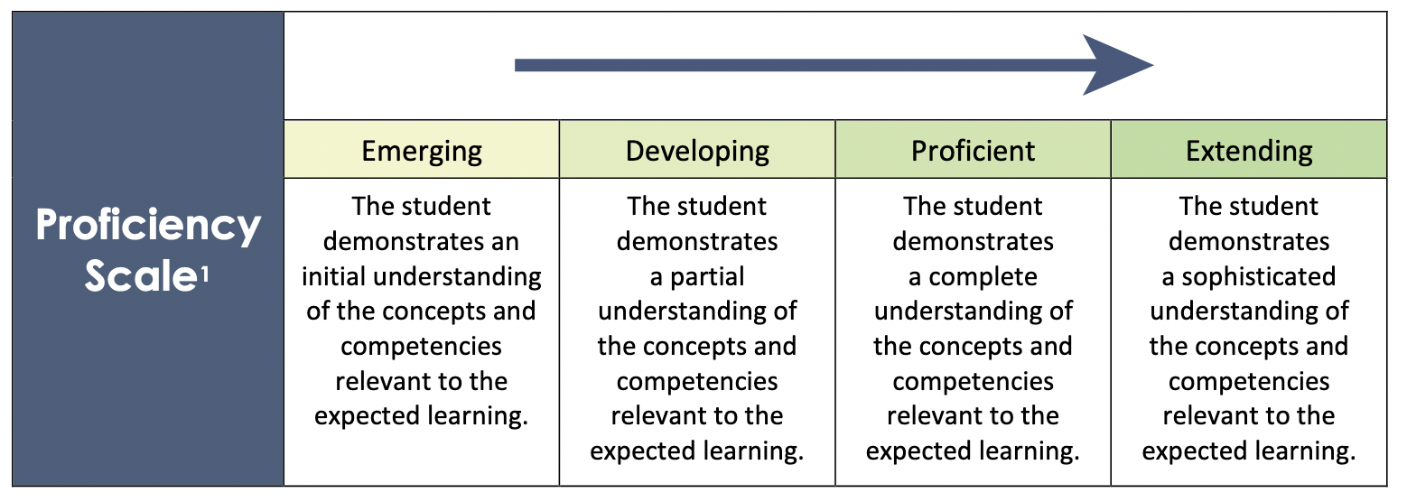
What is the New Policy?
The brand-new K-12 BC Reporting Policy will make its first appearance on July 1, 2022 with the goal of supporting all learners and enhancing inclusion, student self-assessment measures, and goal-setting which will ultimately help students, parents, and caregivers become aware of student progress.
The policy gives an explanation of the requirements for reporting on student growth and learning which consists of clear descriptive feedback and the application of the Provincial Proficiency Scale.

Slide 4
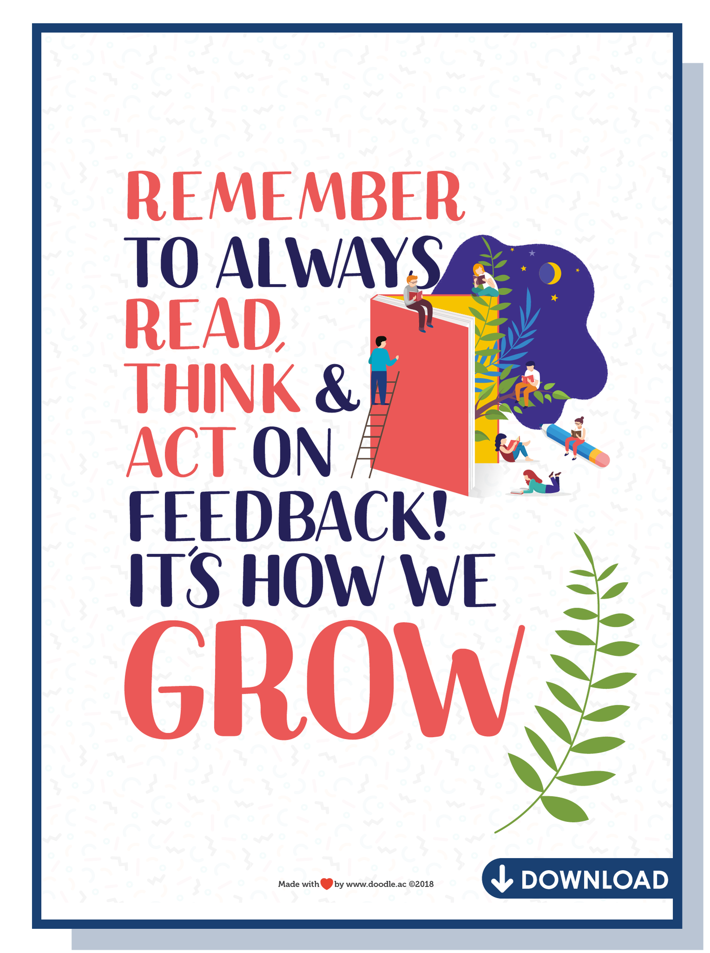
Definitions Integrated into the New Policy and Ties to the BC Curriculum
Core Competencies – Communication, Thinking, and Personal and Social are necessary proficiencies to help students in the present and future in becoming lifelong learners.
Descriptive Feedback – Quality written comments that are in clear language that will be available on a continuous basis for parents/caregivers to visualize the students’ performance and progress based on the Learning Standards.
Learning Updates – Based on the Learning Standards of the BC Curriculum, parents/caregivers will be provided with regular updates about the student and their progress to ensure that guardians are conversant about the learning journey.
Learning Standards – The skills, strategies, and operations that students develop over a time period including the content Learning Standards which consist of the appropriate grade level topics, as displayed in the BC Curriculum.

Slide 5
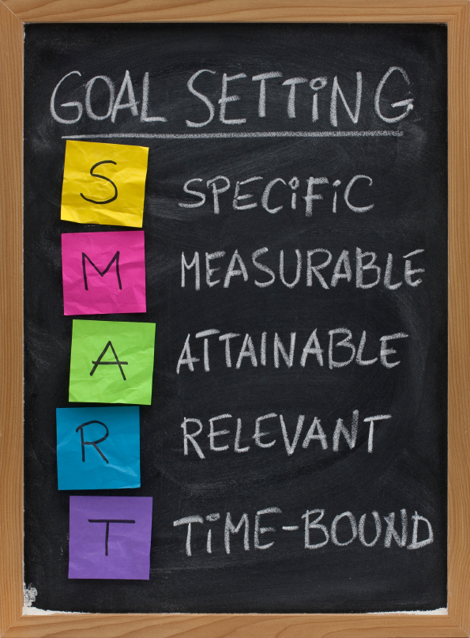
Definitions Integrated into the New Policy and Ties to the BC Curriculum Continued…
Provincial Proficiency Scale – The four classifications of student performance including Emerging, Developing, Proficient, and Extending.
Student Goal Setting – Students will make effective plans for their learning and growth over the present school year by setting inspiring goals. This will eventually lead them to think about future career opportunities, and plans for college and university which effectively connects to the Core Competencies of the BC Curriculum.
Student Self Assessment – Students will reflect on their process of growth and learning to expand the Core Competencies for themselves as lifelong learners.
Summary of Learning – A summative, quality written report given to guardians that will effectively narrate the students’ individual progress at the conclusion of the school year.

Slide 6
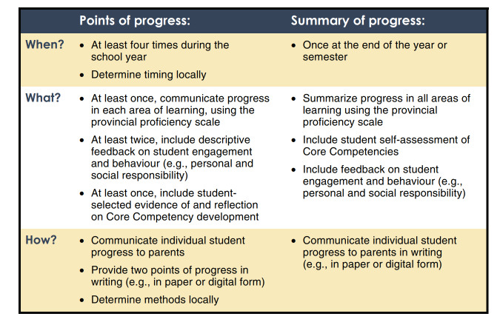
Summary of Learning: When, What & How
Very specific guidelines and timelines in new reporting policy
Student’s role in new policy
Expansive amount information

Slide 7
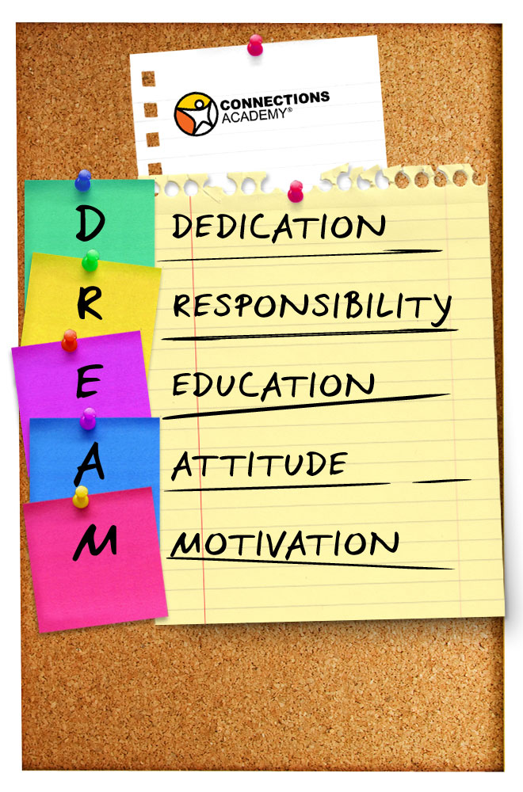
Educ 421 – Assessment & Motivation: How Assessment Practices are Conducive to Learning
Assessment practices can enhance motivation while determining whether the student is effectively progressing with the given material and what he or she must work on in order to improve.
According to Erkens, Schimmer and Vagle (2017), “In many cases, learning has been less about proficiency and more about earning points” (p. 14). With the new BC Reporting Policy Draft, the goal is to stay clear of this way of thinking.
Erkens, Schimmer and Vagle (2017) state that “when the communication of the results clearly points to what comes next in the learning, students can then operate with a high degree of interdependence, hope, and efficacy as they strive to improve along the way” (p. 39). This quote can encapsulate the importance of descriptive feedback as outlined in the new BC Reporting Policy Draft for K-12 education.

Slide 8

Educ 421 – Assessment & Motivation: Key Characteristics that Ground Student Investment
According to Erkens, Schimmer and Vagle (2017), “Students invest when they believe that they can do it, they know what to do next, and the work is meaningful and worth their time, making self-regulation an integral component of student investment” (p. 120). Self-regulation involves how to cope with big emotions and the ability to be adaptive. Children need to learn this before emerging into adulthood and they will invest in their learning when they recognize that making mistakes is acceptable and it is all part of the learning journey.
Erkens, Schimmer and Vagle (2017) recognize that “positive interactions such as teacher to student and student to student can enhance a learner’s desire to invest” (p. 120). Safe and effective classroom climate and cultures will ground student investment through shared goal-setting and encouragement.

Slide 9
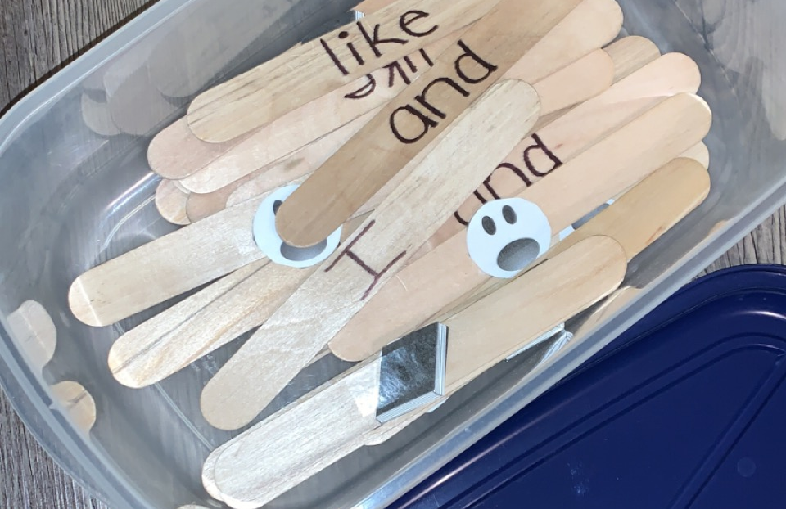
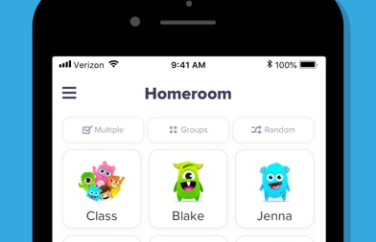
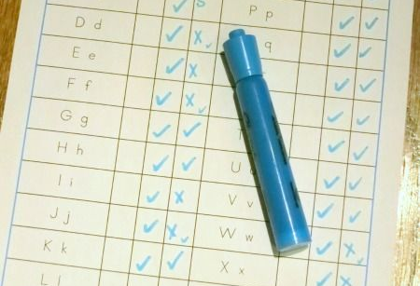
Practicum/Assessment/Reporting in a Kindergarten Classroom
Recognized that kindergarten is primarily about the progress of each individual student; rather than standardized assessments.
It is highly important to make learning activities fun and simple for the students to demonstrate mastery and what areas they may need help in to improve.
Kindergarten students cannot sit for too long and lessons must remain exciting and quick with a large amount of movement breaks in between.
Some assessment practices used included ‘thumbs up/thumbs down’, asking questions to spark discussion, the think, pair and share strategy, and games such as sight word games with popsicle sticks.
Had the opportunity of pulling individual students to the back of the classroom to work one-on-one to assess their letter and sound recognition which is used primarily for kindergarten report cards and progress reports on a three month basis.
Classroom ‘Dojo’ App for digital reporting of daily activities and student progress provided as evidence for students and their parents/caregivers.

Slide 10
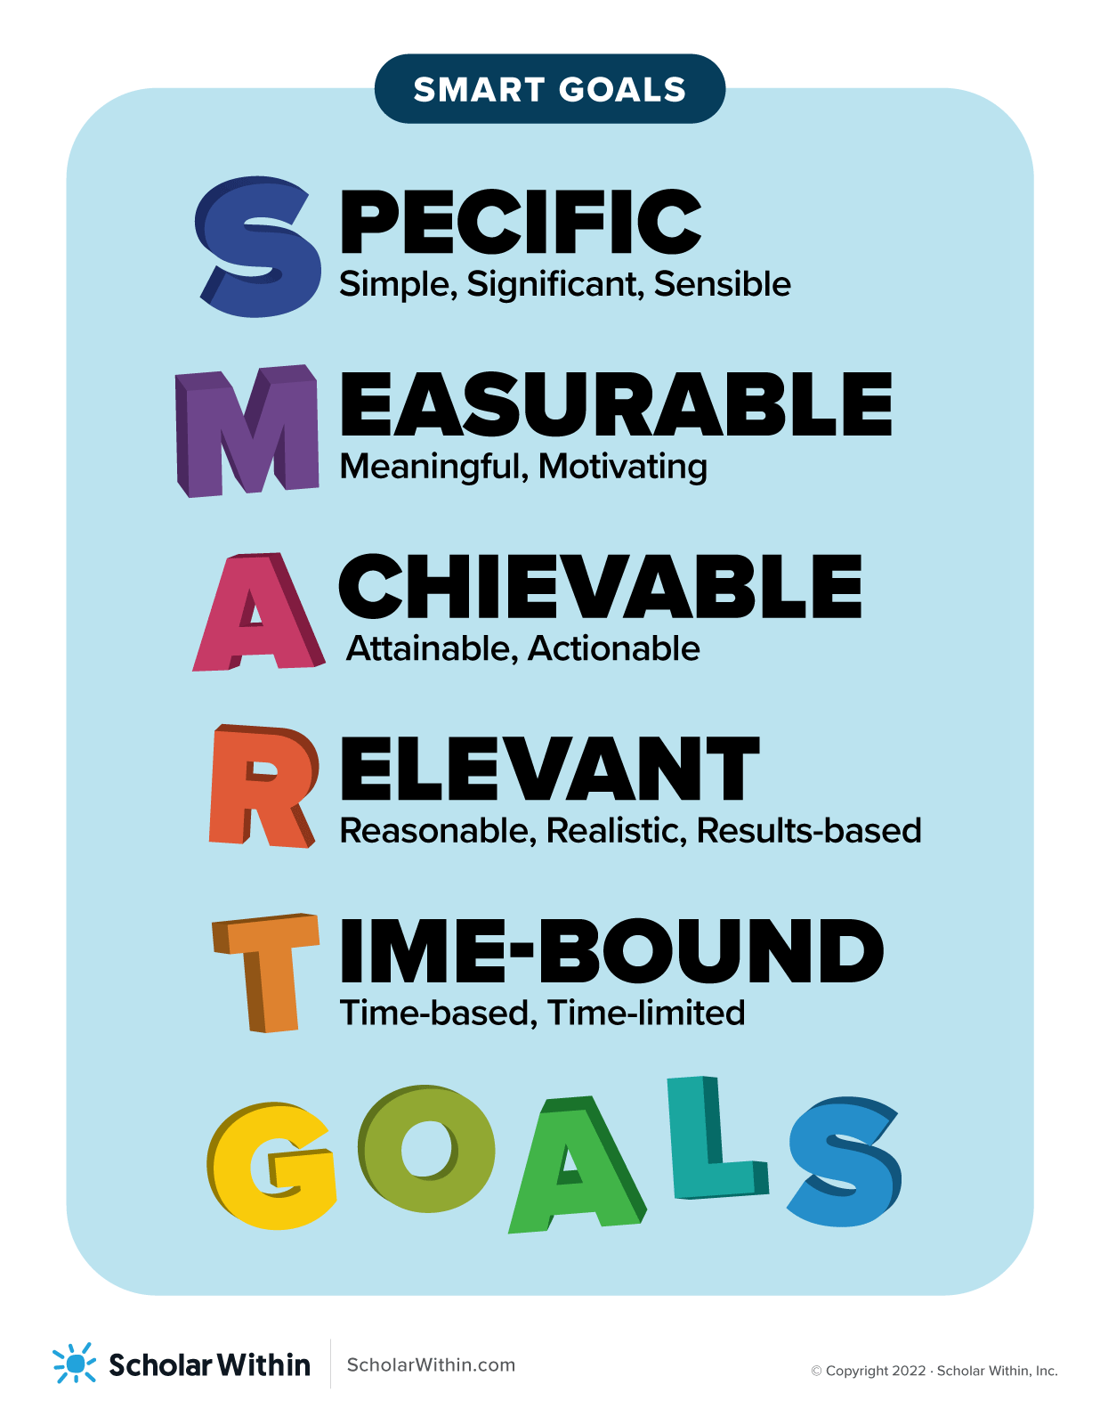
Practicum Assessment & Reporting in a Grade 2/3 Classroom
Engaging students thinking and generating conversation
Goal setting, SEL learning, time for reflection
Provide sufficient thinking time for students
Focus on Instructional Agility throughout lessons

Slide 11
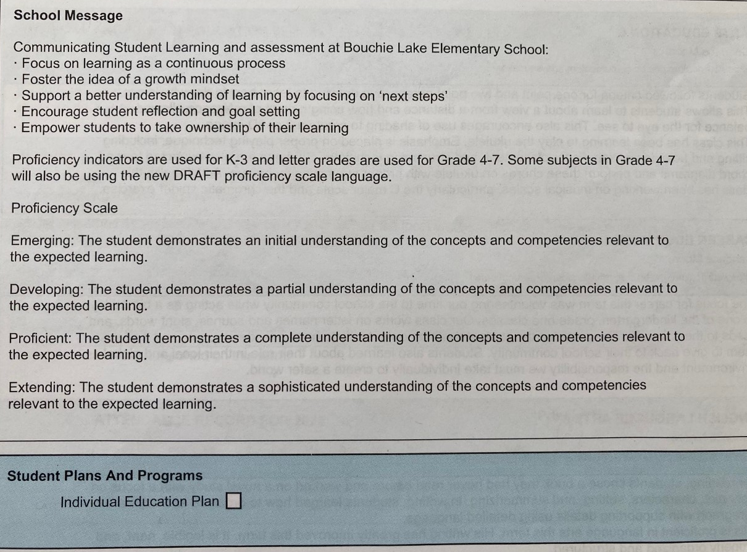
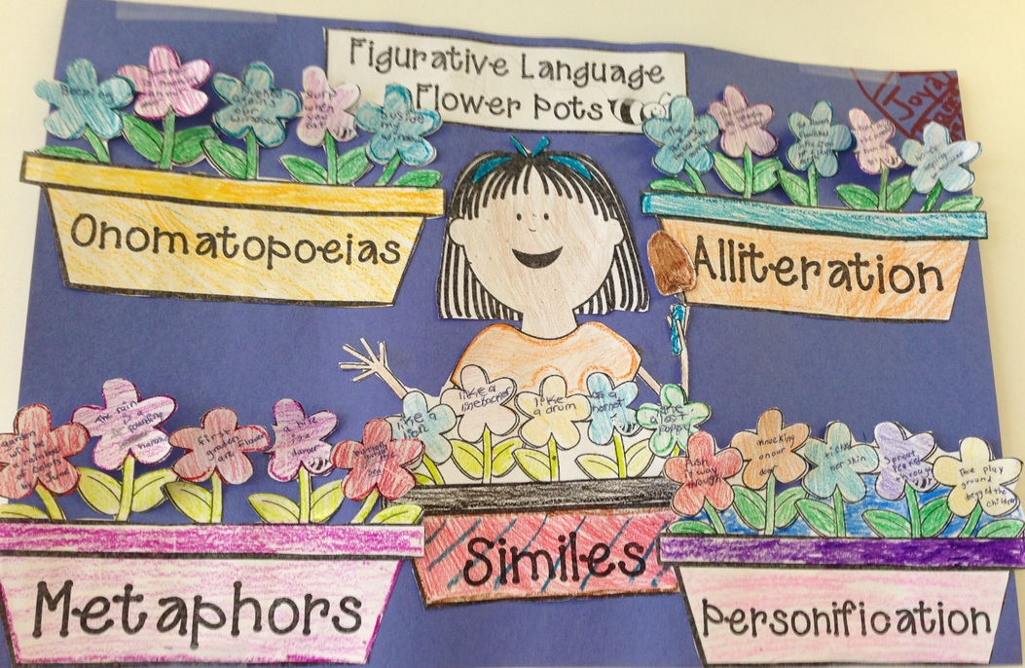
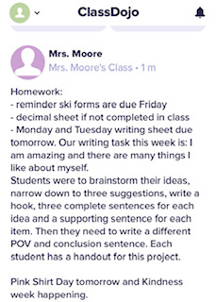
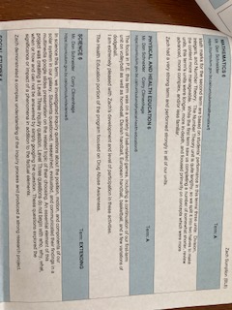
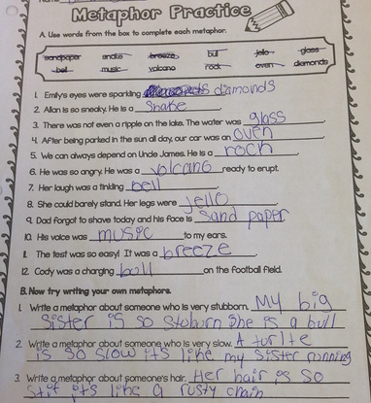
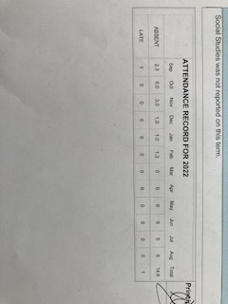
Communicating Students Learning: (Report Cards)

Slide 12
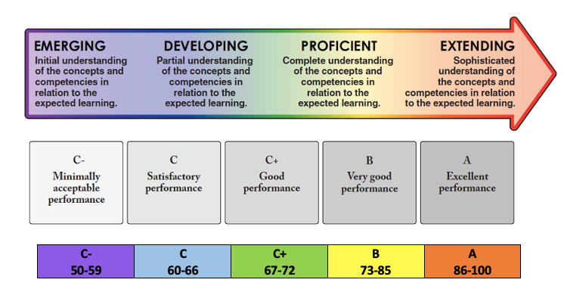
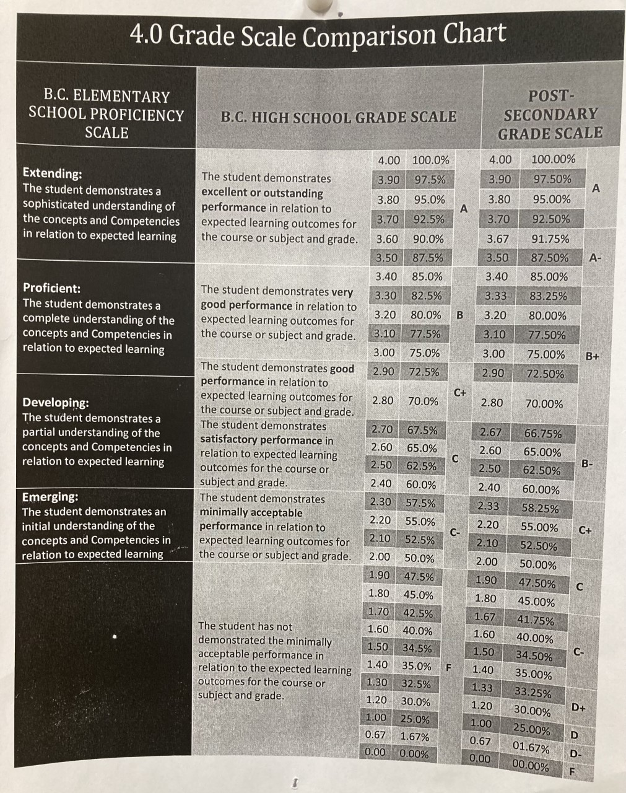
Issues or Concerns with the new reporting system:
“The continued use of percentages and letter grades at the 10–12 grade level both invalidates and disrespects the newer K–9 assessment model” (BCTF)
If grades 10-12 shift to a proficiency scale how will this affect University and scholarship eligibility?
Comparison Charts in schools
Currently multitude of options and flexibility for reporting (MyEd, FreshGrade, Digital Portfolios, etc) as seen on next slide.

Slide 13
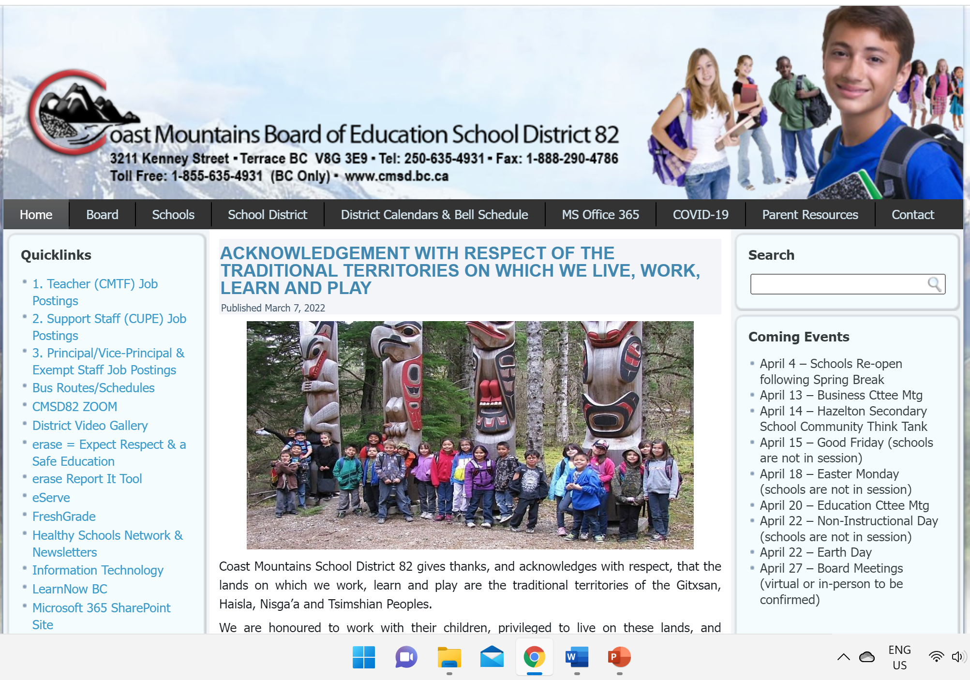
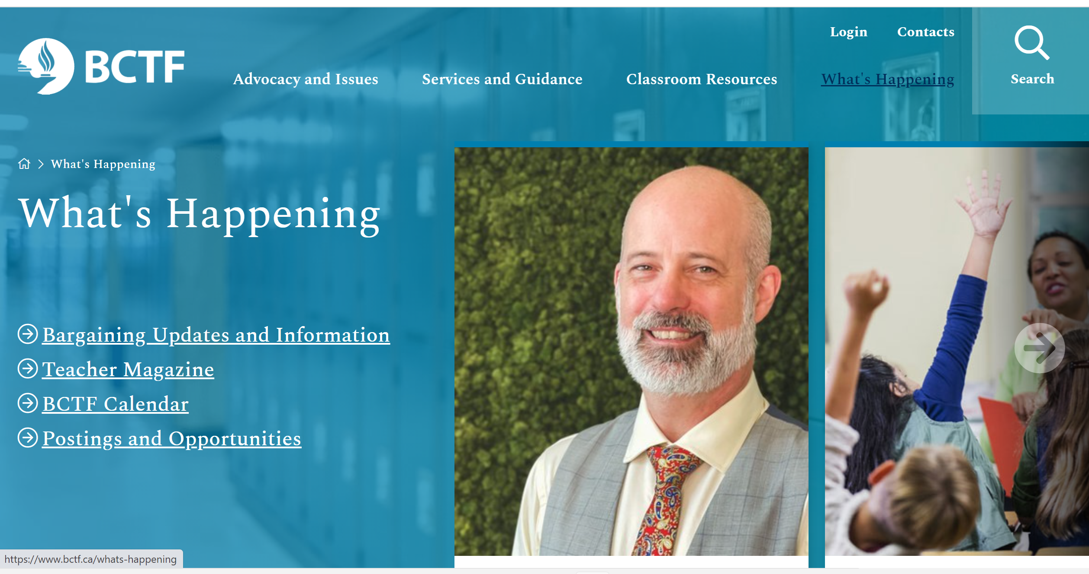
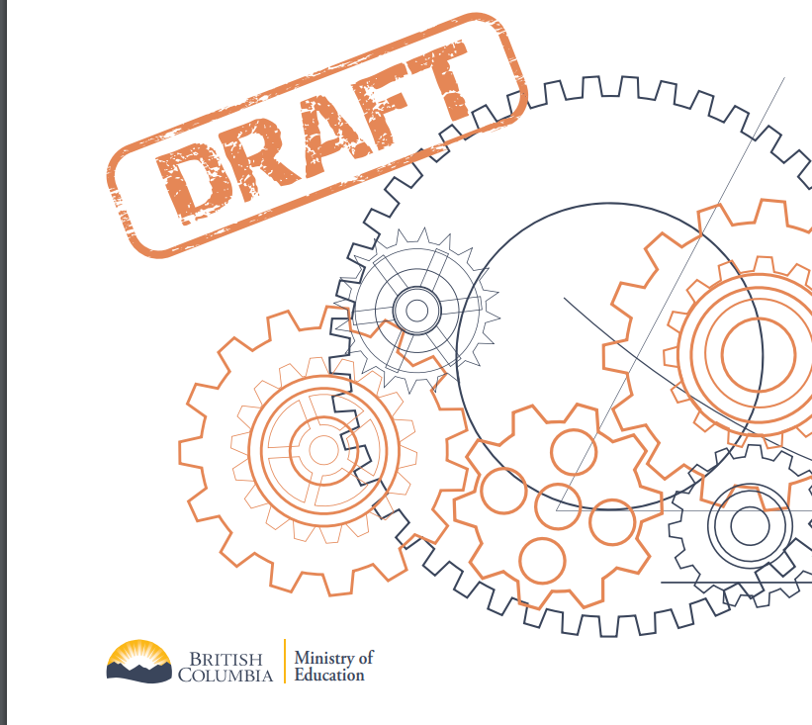
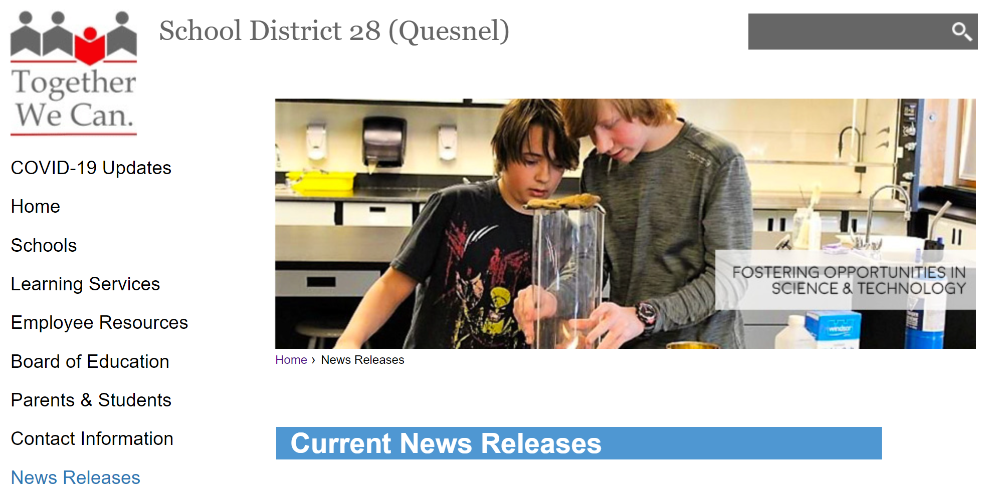
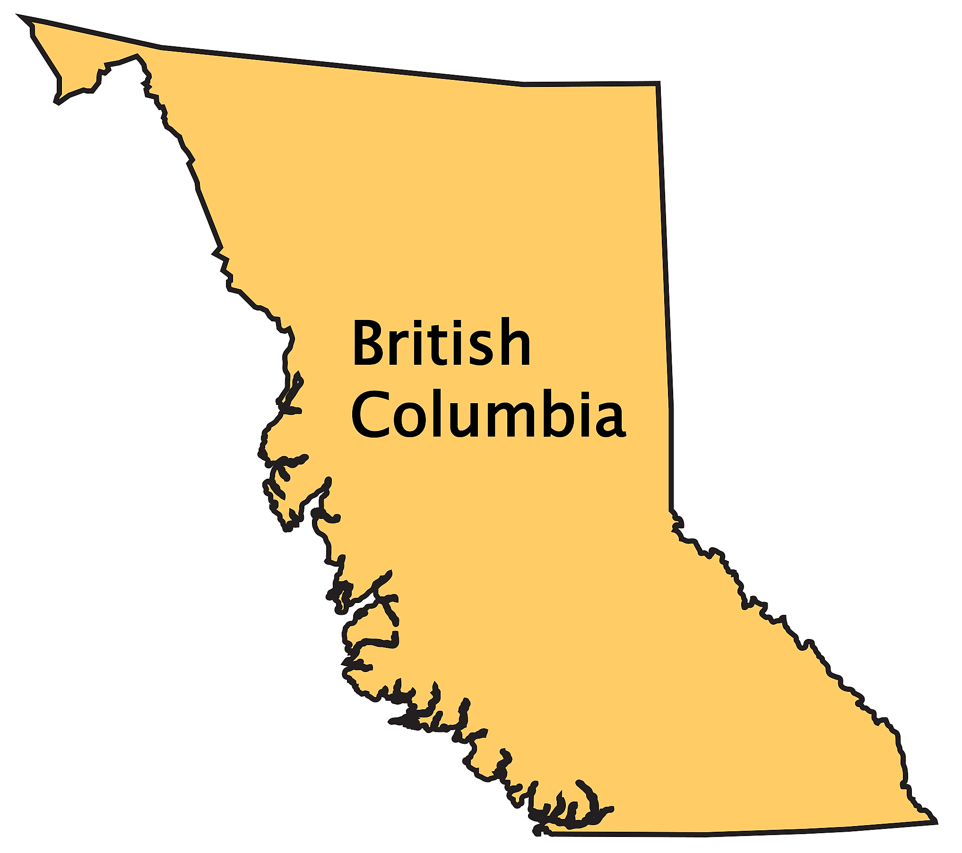
Stay Tuned…

Slide 14

References:
Erkens, C., Schimmer, T., & Vagle, N. D. (2017). Essential assessment: Six tenets for bringing hope, efficacy, and achievement to the classroom. Solution Tree Press, the Solution Tree Assessment Center.
https://www.bctf.ca/whats-happening/news-details/2021/10/27/bctf-response-to-the-draft-k-12-reporting-order
https://curriculum.gov.bc.ca/sites/curriculum.gov.bc.ca/files/pdf/reporting/student-reporting-policy-pilot-handbook.pdf
https://engage.gov.bc.ca/app/uploads/sites/121/2021/09/Draft-K-12-Student-Reporting-Policy.pdf
https://www.insidehighered.com/news/2020/04/13/how-will-passfail-affect-students-future
https://learn71.ca/wp-content/uploads/2019/09/Digital-Portfolio-Backgrounder-for-Teachers.pdf
https://portal.sd47.bc.ca/class/7fy46vr/Documents/Rethinking%20Reporting_Jaki.pdf
https://www.thoughtco.com/grading-for-proficiency-in-the-world-of-40-gpas-4125695
https://tutoringwithatwist.ca/new-bc-report-cards/
https://vancouversun.com/news/local-news/how-digital-report-cards-are-changing-schooling
https://www.sd35.bc.ca/students-parents/communicating-student-learning-report-cards/

Slide 15

Questions

