Slide 1
CARLY LORNTSEN
Capstone Presentation
Education 401
Dr. David Litz
UNBC School of Education

Slide 2
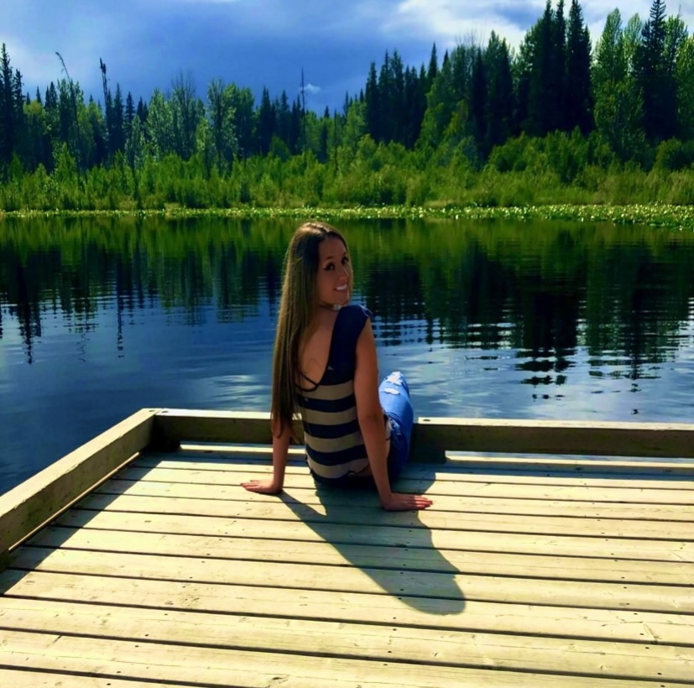
JOURNEY
My

Slide 3
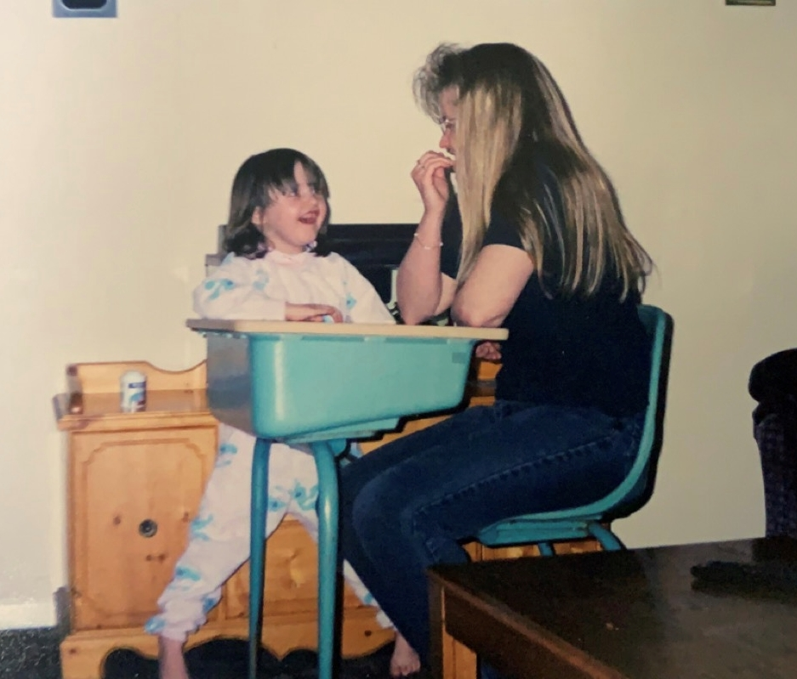
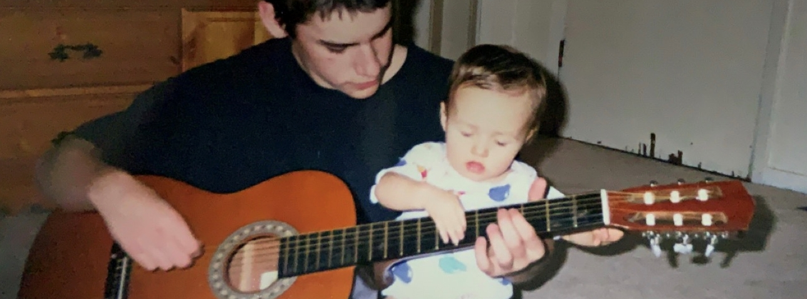
EARLY
YEARS

Slide 4
IN PUSHING ME TO WANT TO BECOME A TEACHER
INFLUENCES

Slide 5
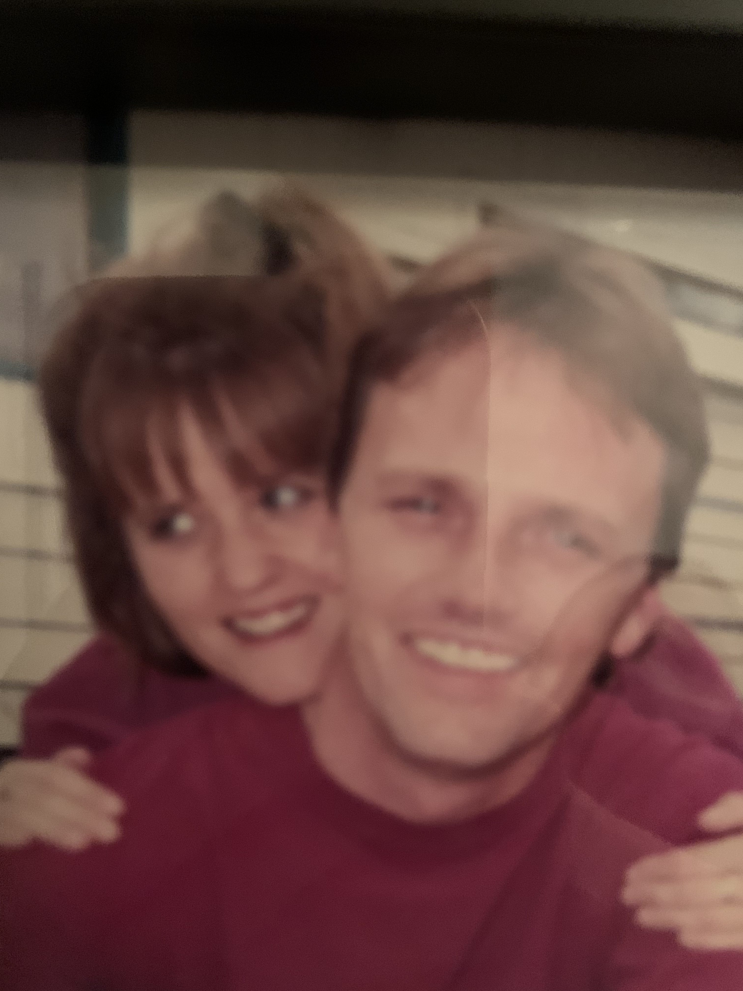
In pushing me to want to become a teacher continued
INFLUENCES

Slide 6
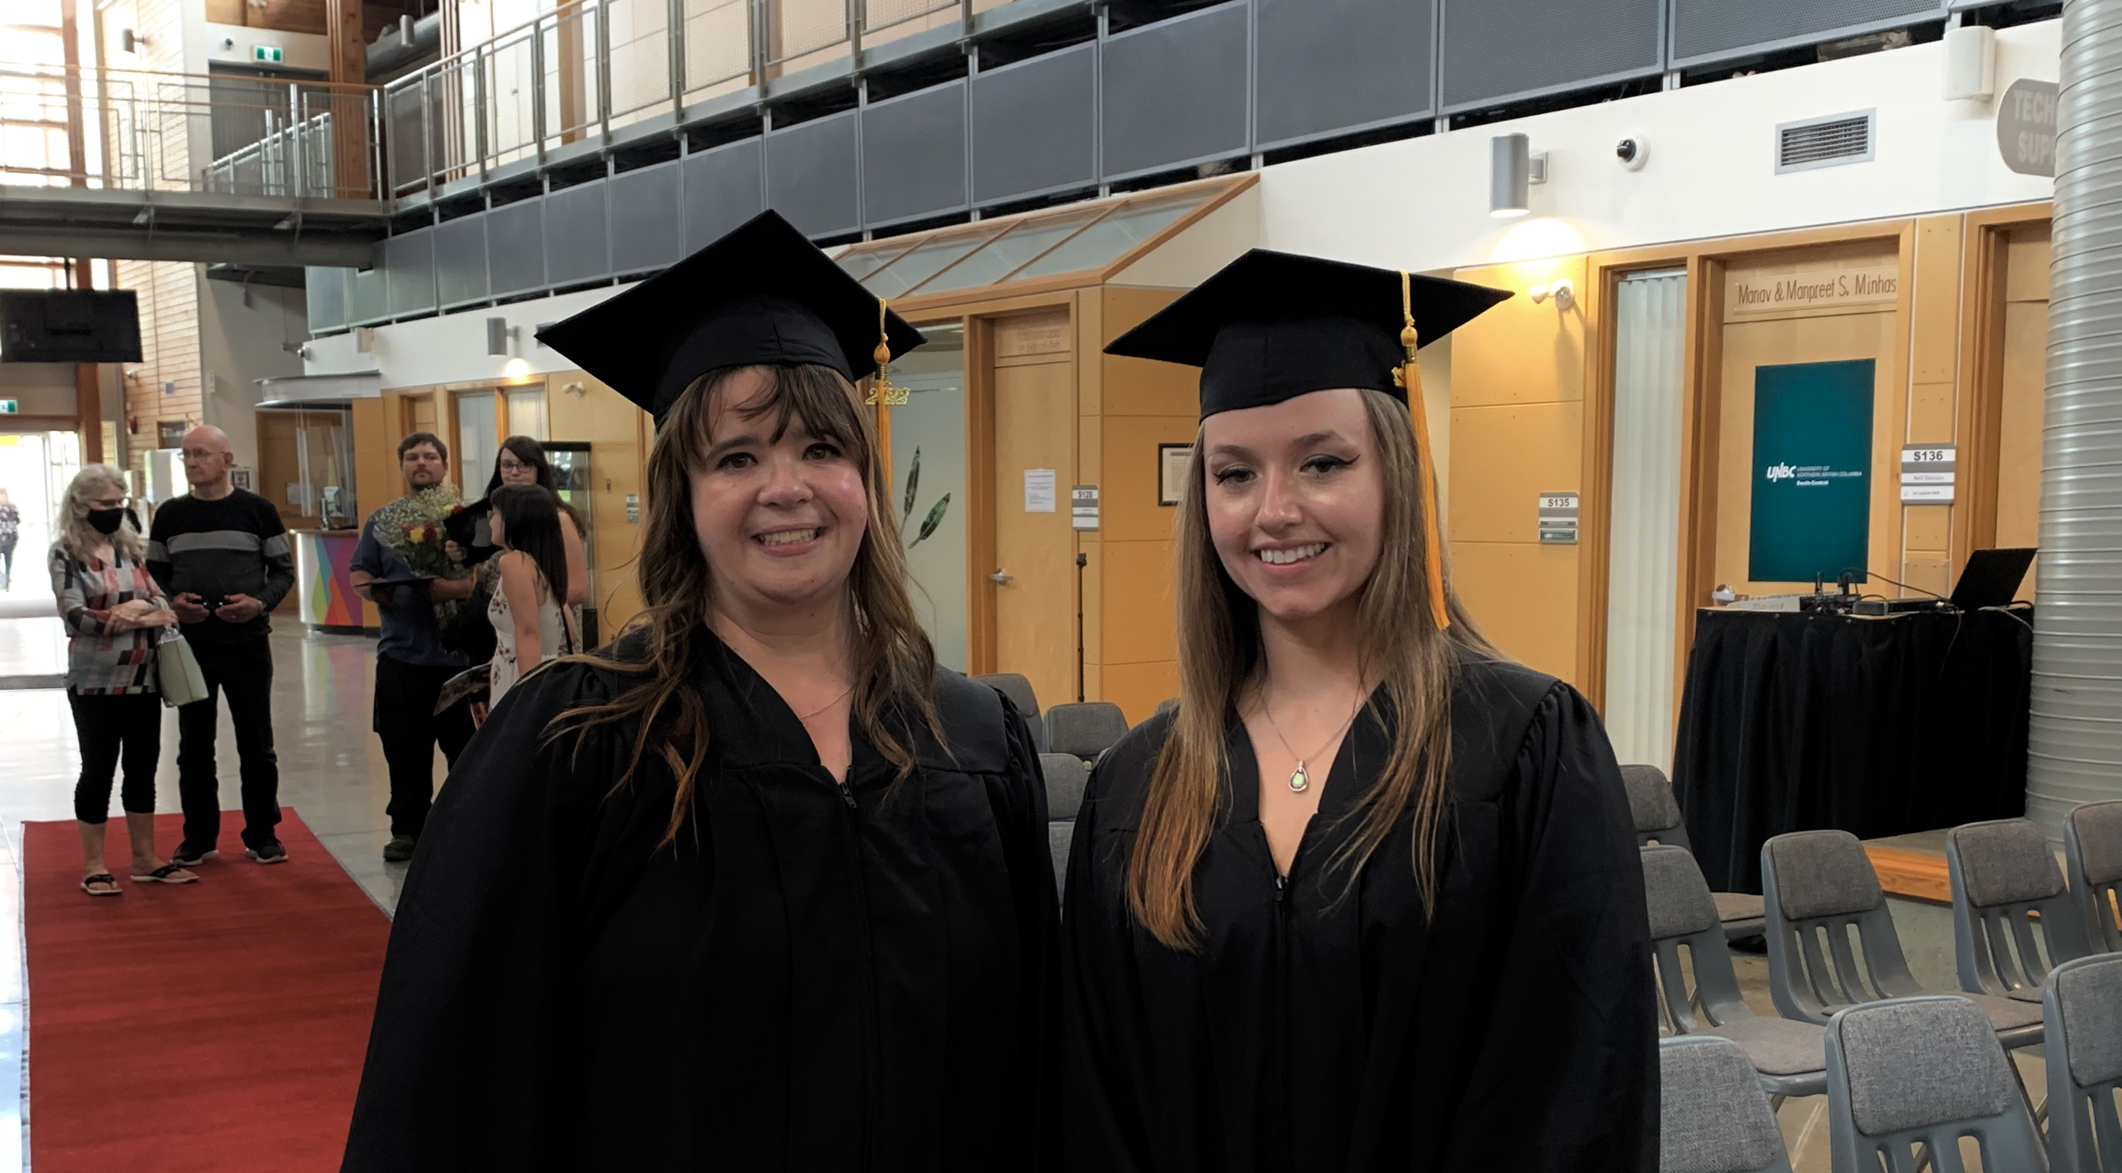
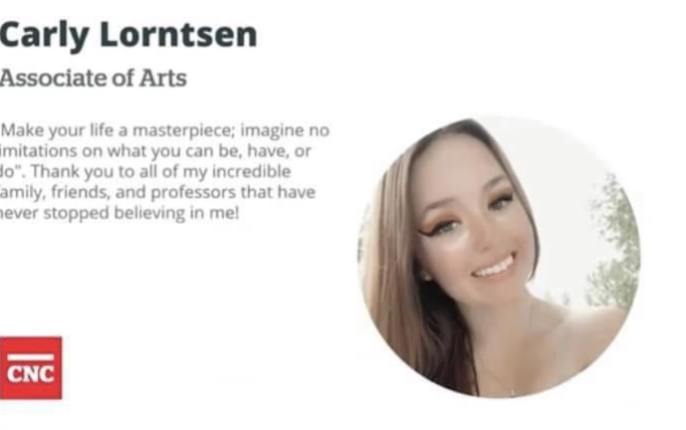
POST-SECONDARY
EXPERIENCES

Slide 7
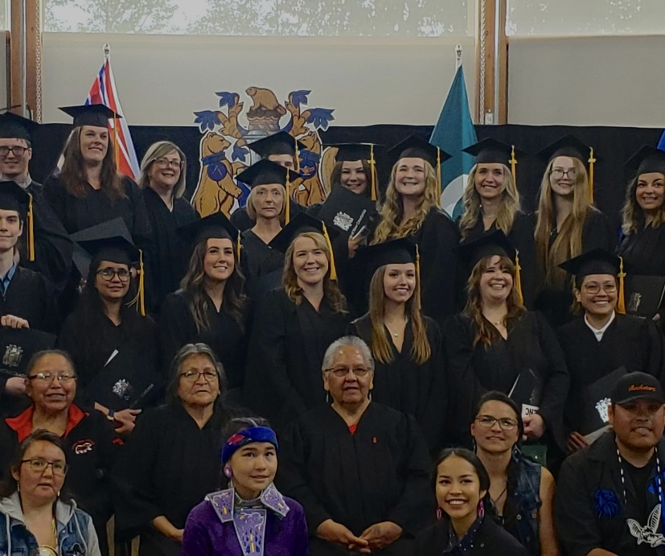
EXPERIENCES CONTINUED
POST-SECONDARY

Slide 8
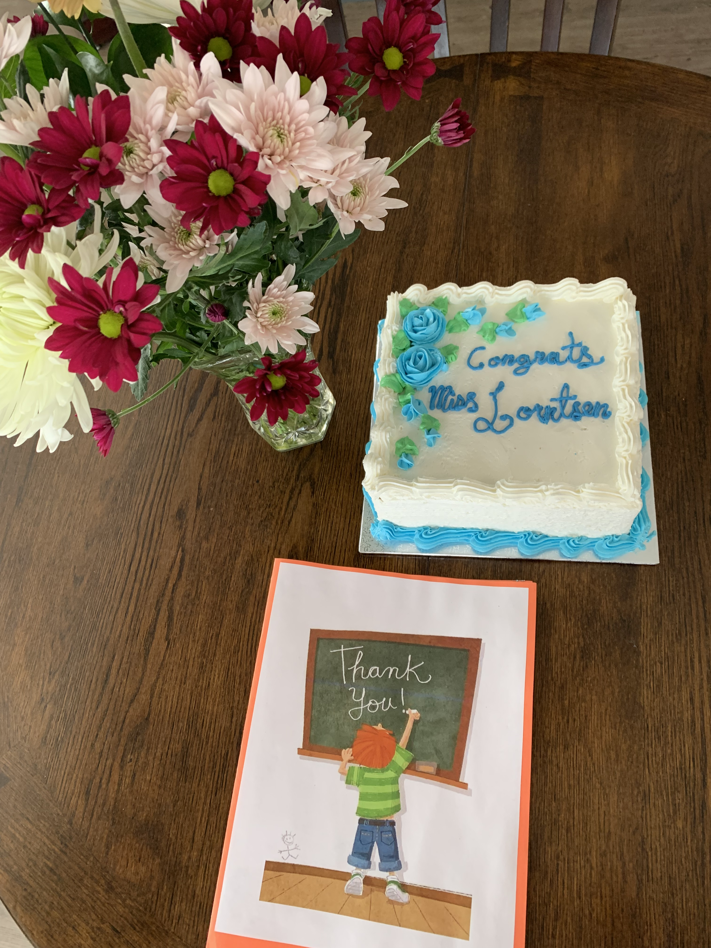
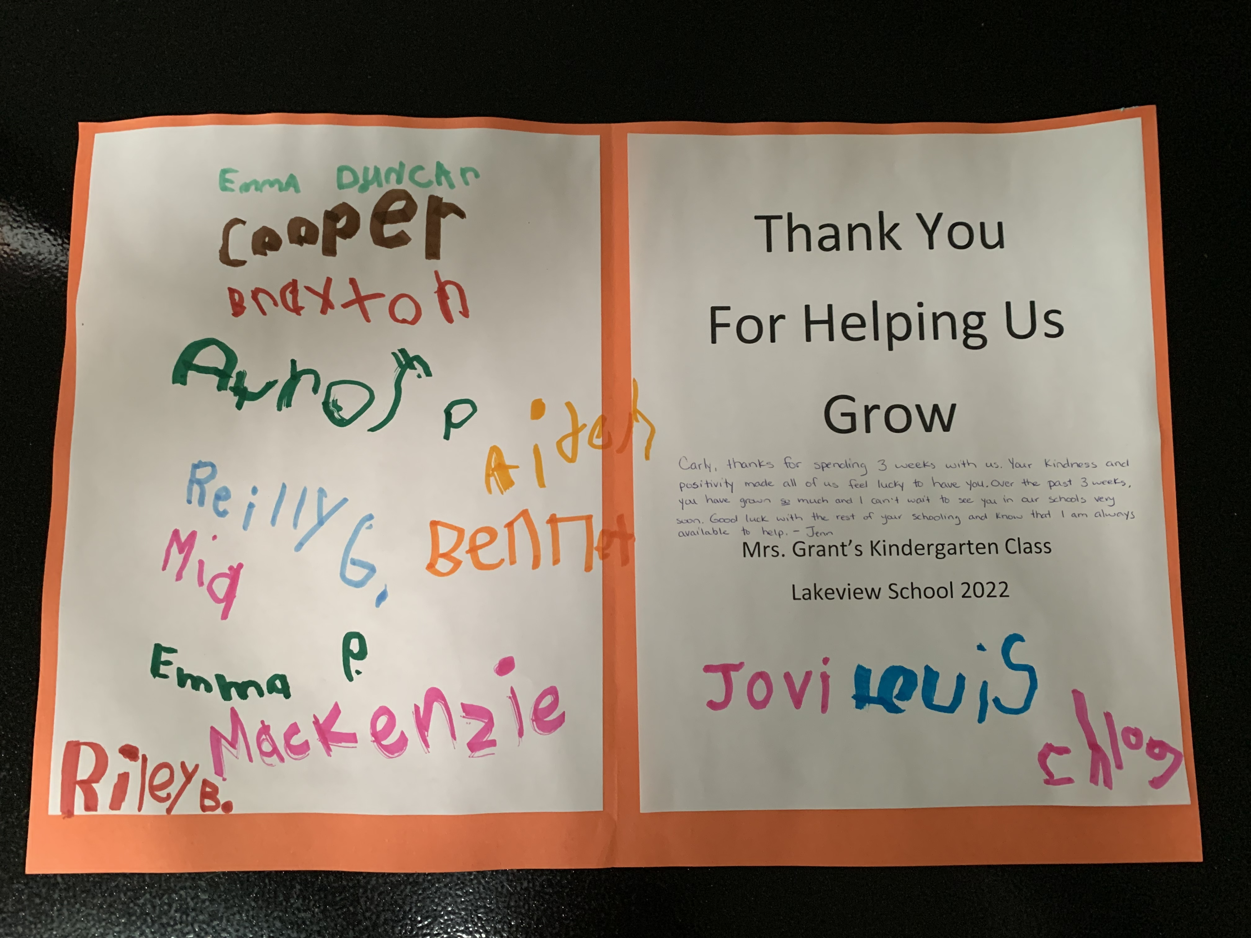
REACHING
GOALS

Slide 9
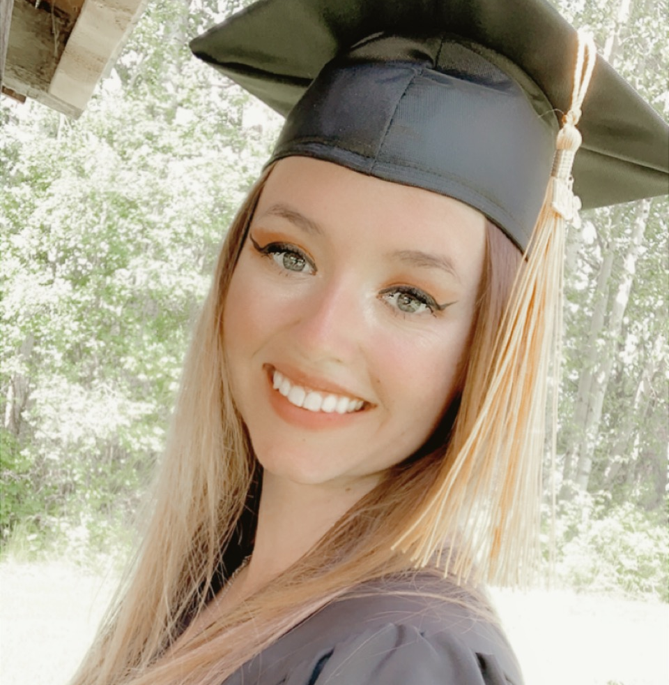
THEORY IN MY PERSONALIZED CAREER DEVELOPMENT
NARRATIVE

Slide 10
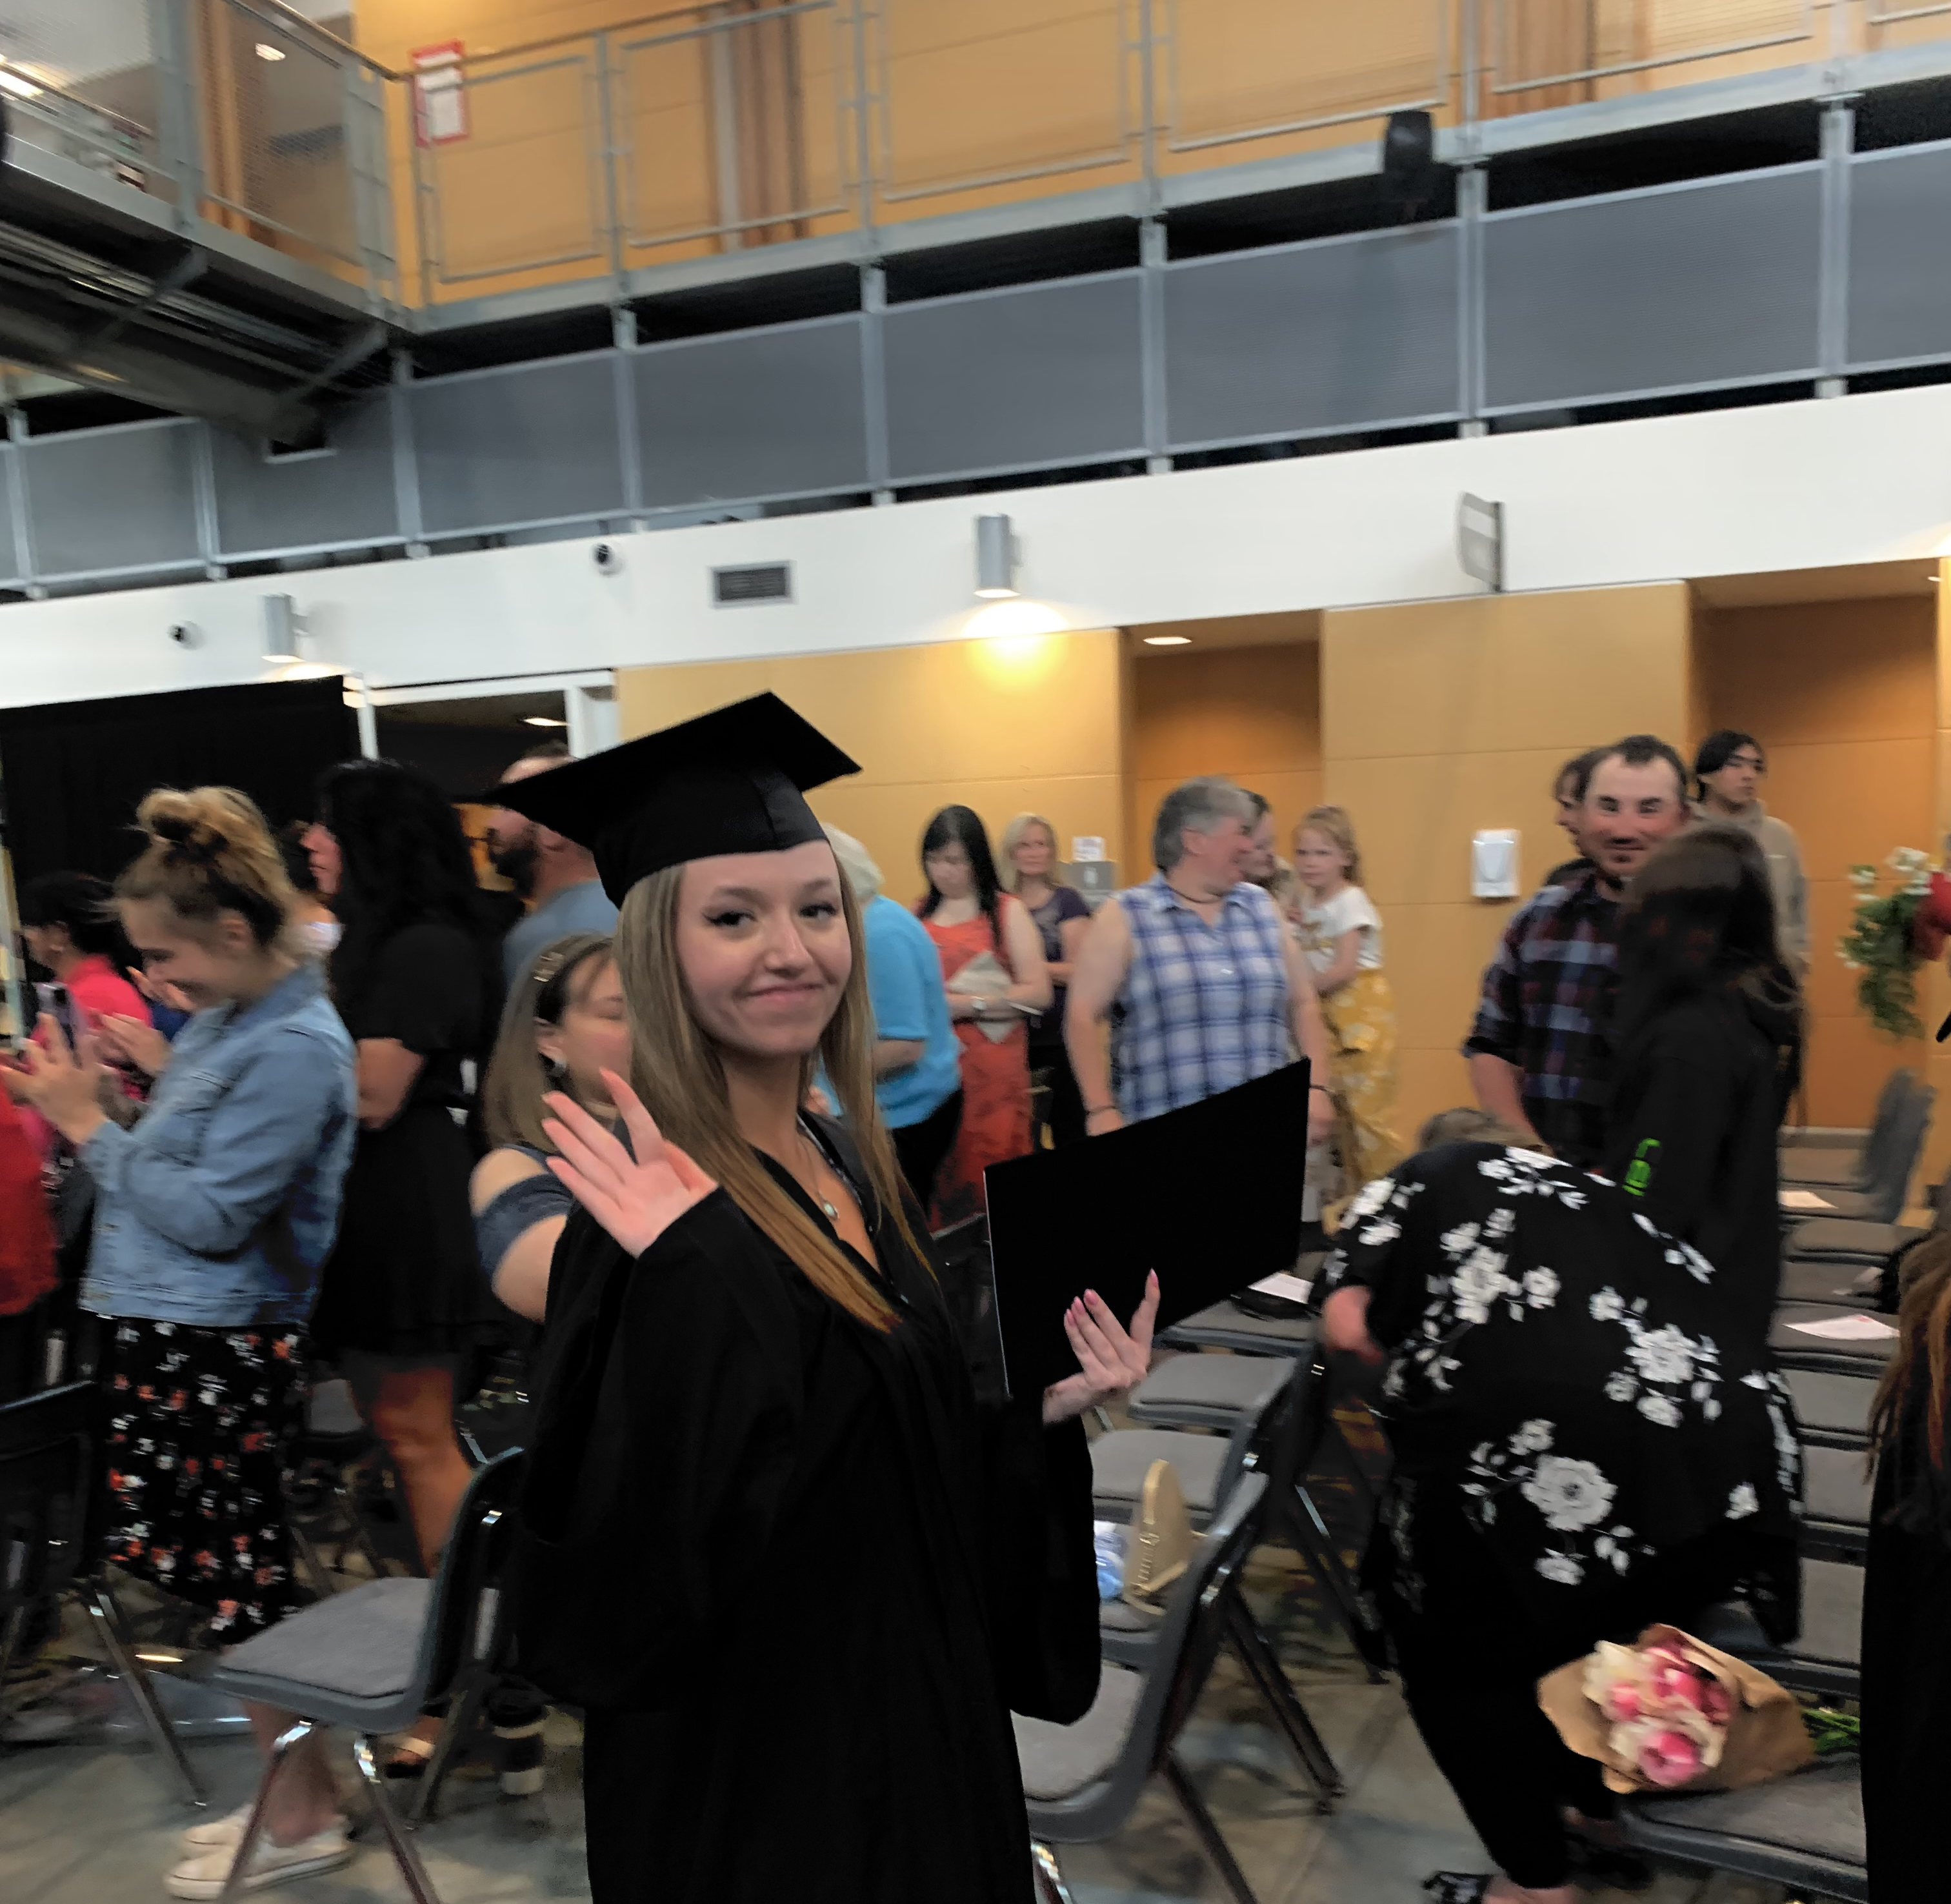
CONCLUDING THOUGHTS AND FUTURE STEPS

